Slide 1
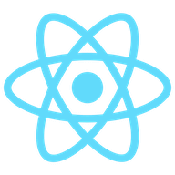
Getting Started With
React.Js
By- Tushyap Bari

Slide 2
What is React.js ?
React is a free and open-source front-end JavaScript library for building user interfaces based on UI components.
It is maintained by Meta and a community of individual developers and companies.
React can be used as a base in the development of single-page or mobile applications.

Slide 3
Why React.js ?
The main objective of ReactJS is to develop User Interfaces (UI) that improves the speed of the apps.
It uses virtual DOM (JavaScript object), which improves the performance of the app.
The JavaScript virtual DOM is faster than the regular DOM.
Simplicity-ReactJS uses JSX file which makes the application simple and to code as well as understand.
Performance-ReactJS is known to be a great performer.
Components-ReactJS is all about components. ReactJS application is made up of multiple components, and each component has its own logic and controls. These components can be reusable.

Slide 4
How to install ReactJS ?
Prerequisites
Install Node.js :You will need a recent version of NodeJS to run create-react-app, as well as a recent version of Node Package Manager (npm).
Create your React app
Install React-We can install React using npm package manager by using the following command. There is no need to worry about the complexity of React installation. The create-react-app npm package manager will manage everything, which needed for React project.
C:\Users\javatpoint> npm install -g create-react-app
Create a new React project
Once the React installation is successful, we can create a new React project using create-react-app command. Here, I choose "reactproject" name for my project.
C:\Users\javatpoint> create-react-app reactproject

Slide 5
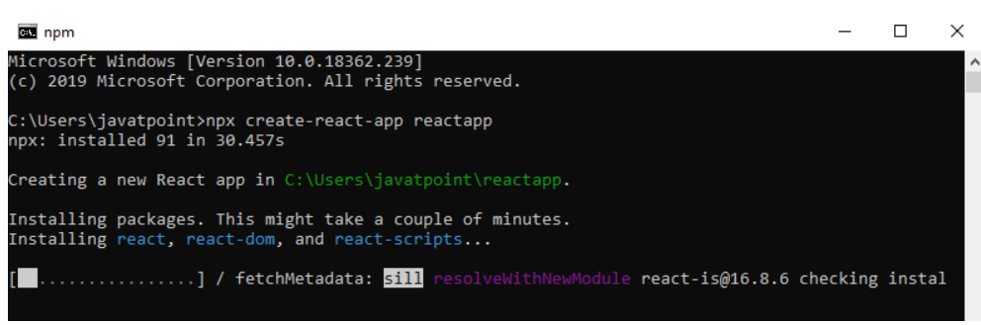
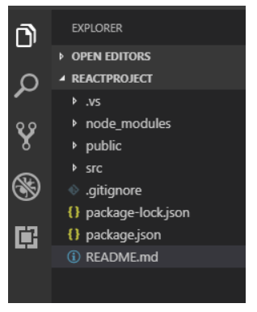

Slide 6
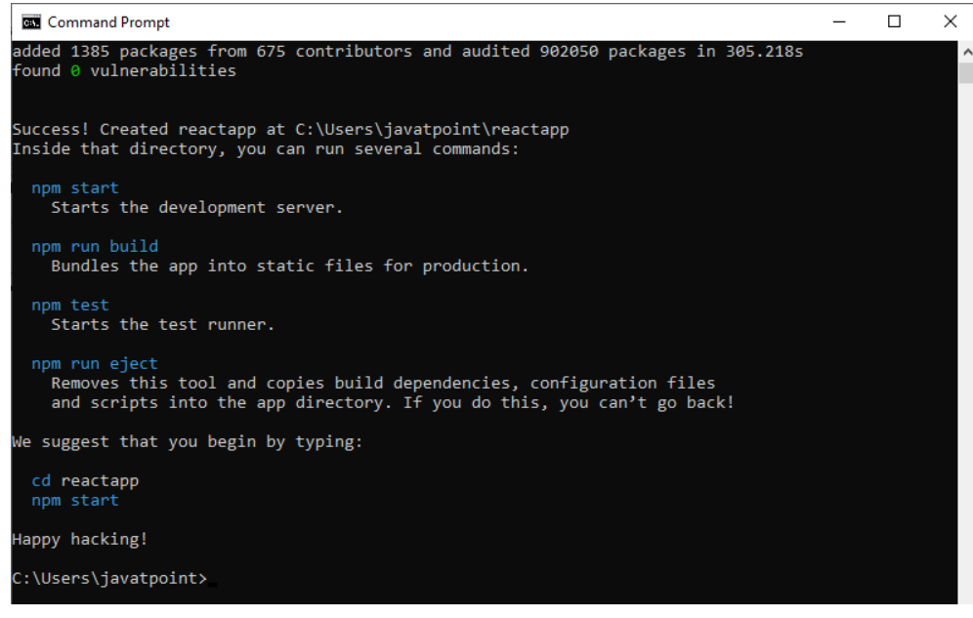

Slide 7
